Slide 1
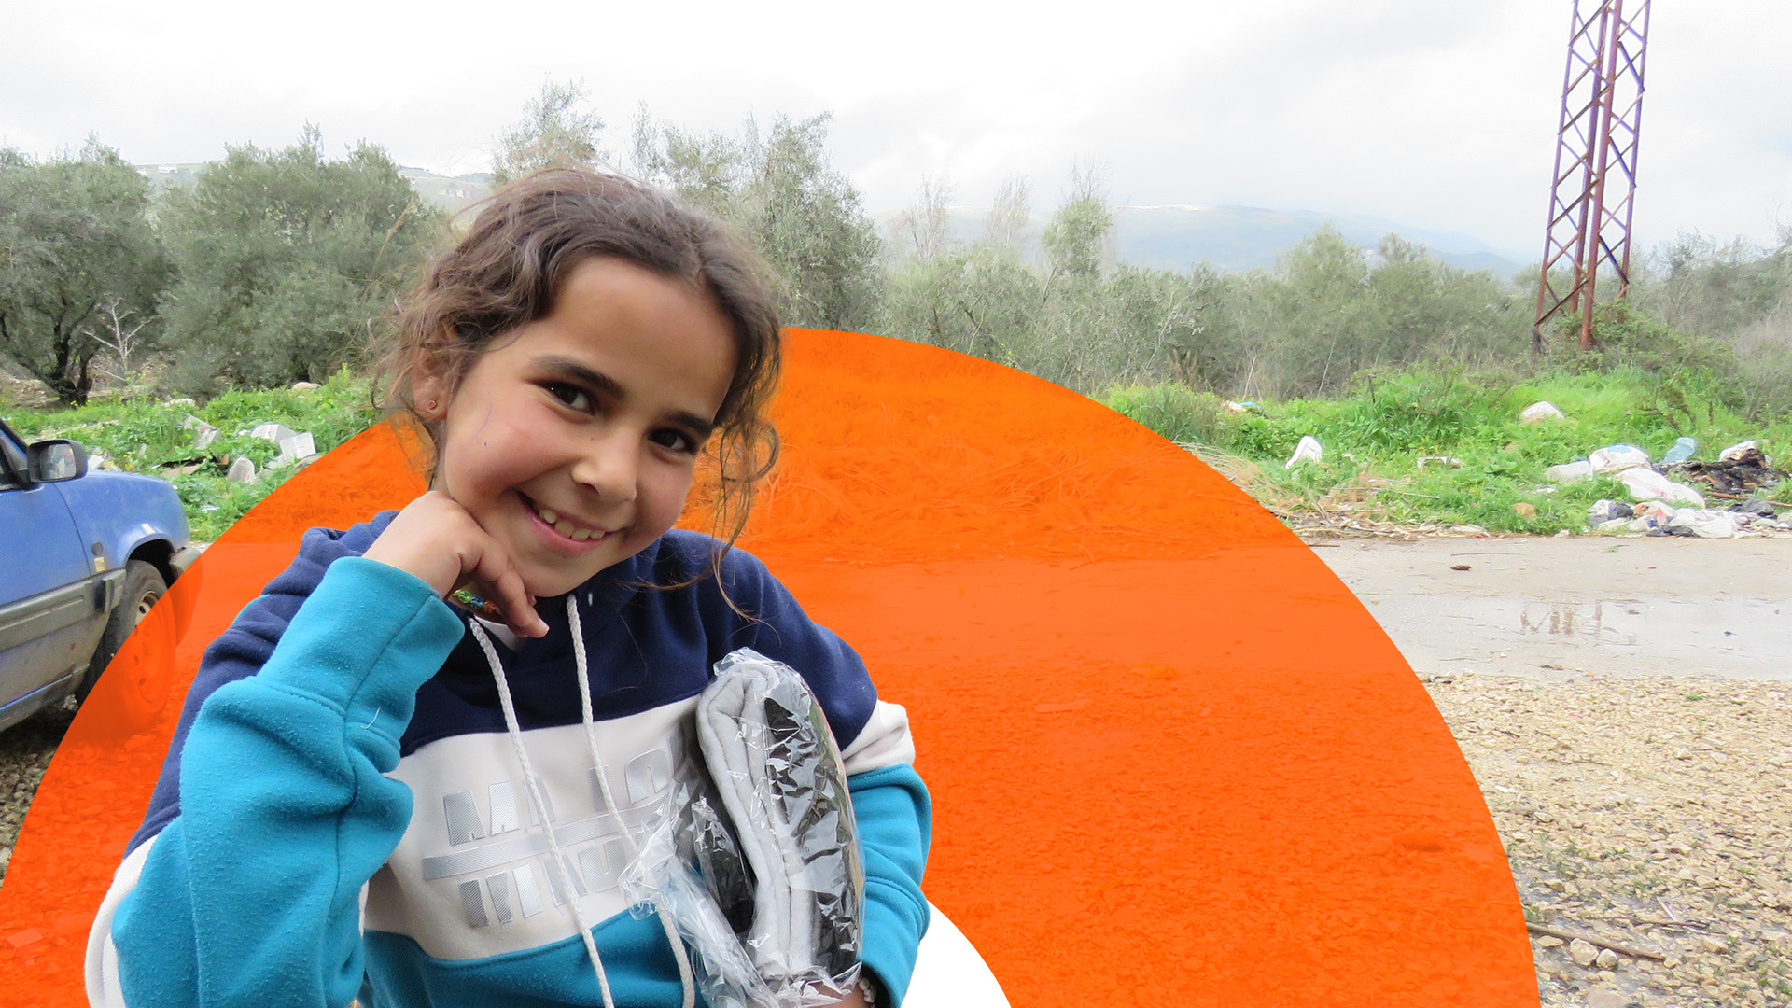
PRAY FOR THE MIDDLE EAST
All photos: © World Vision.

Slide 2
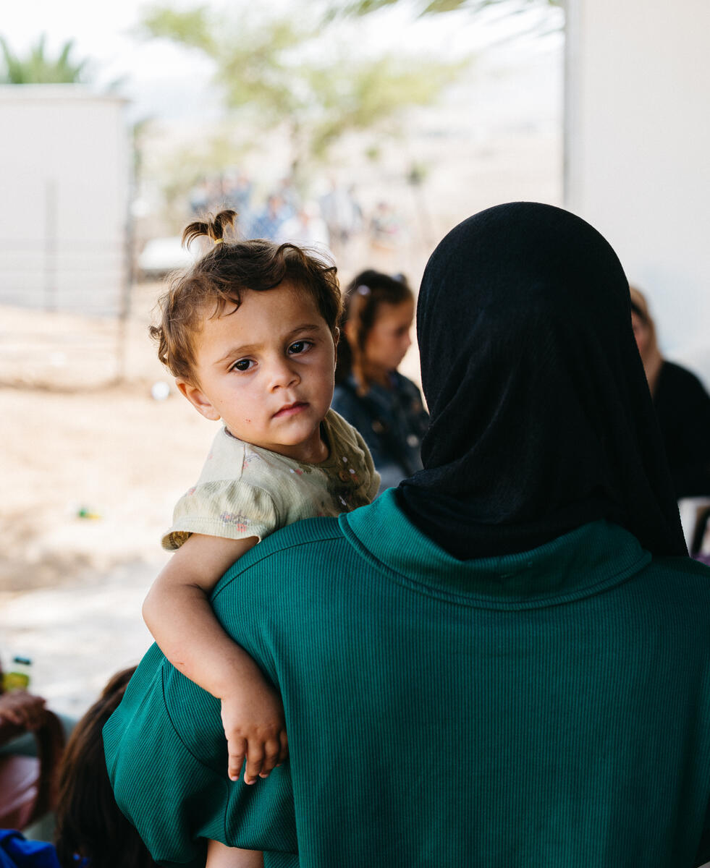
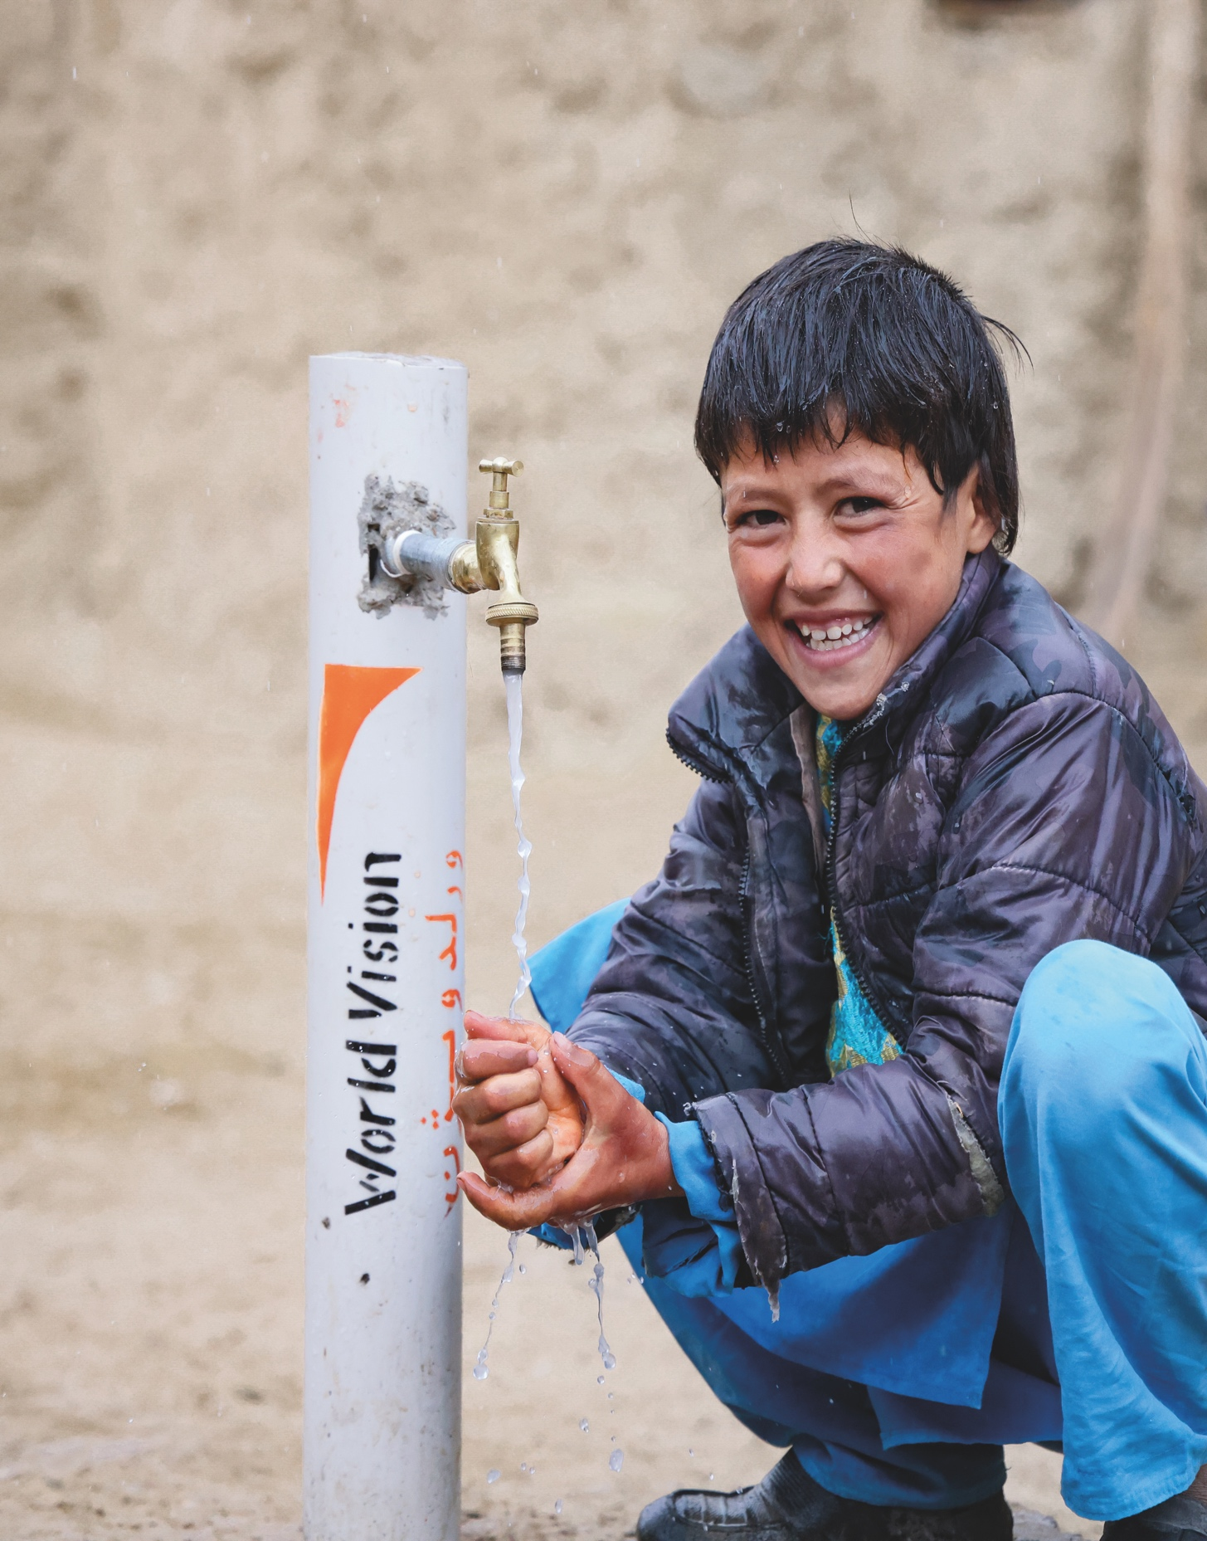
Pray for peace and protection
Pray for peace in the region. Pray that fighting would cease and stability would be restored.
Pray for children and families living in conflict areas, especially for children vulnerable to exploitation, abuse and child labour.

Slide 3
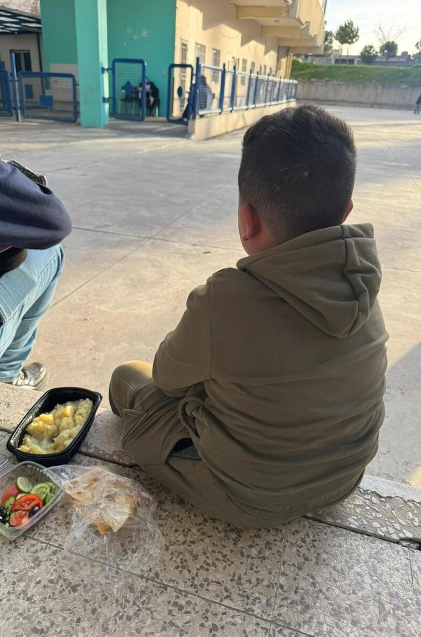
Pray for provision amidst urgent need
Pray for provision for the millions lacking food, clean water, and medical care.
Lift up children facing malnutrition, that they would receive the nourishment they need to survive and grow.
Ask God to multiply resources and open supply routes in hard-to-reach areas.

Slide 4
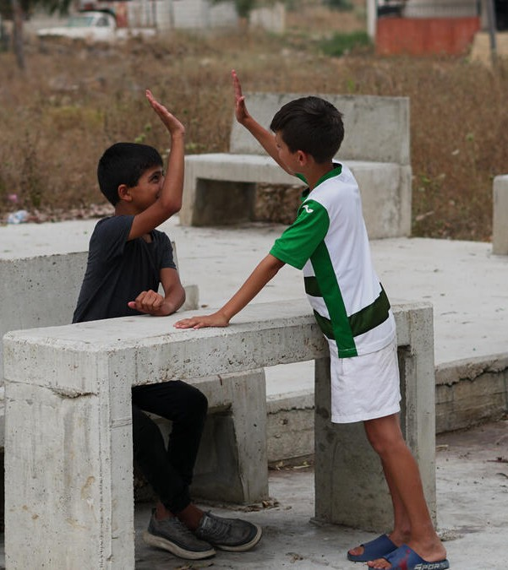
Pray for emotional healing and hope
Pray for children experiencing trauma, fear, and loss. that they would find comfort, healing, and hope
Lift up parents and caregivers under immense pressure, that they would have strength and resilience
Pray for access to safe spaces where children can begin to recover emotionally.

Slide 5
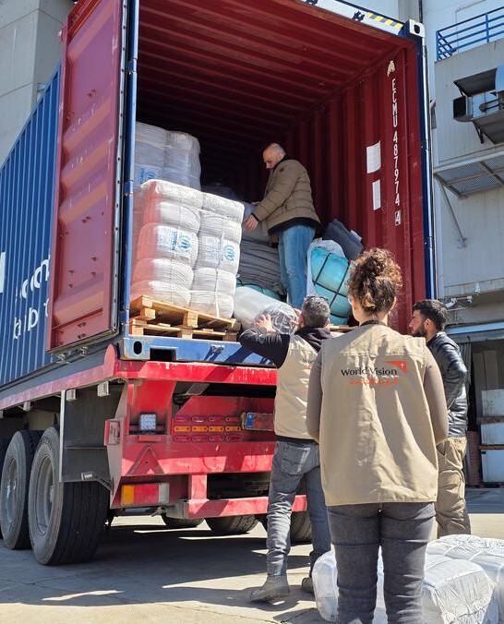
Pray for the response effort
Pray for this response to reach further and faster, that emergency food, hygiene kits and support for displaced families would get to those most in need without delay.
For wisdom and resilience for World Vision teams on the ground and working remotely, particularly in Lebanon, Iraq and the West Bank, as they navigate complex and high-pressure situations.

